Slide 1
INTRODUCTION TO INDUSTRIAL CHEMISTRY
LECTURE-2
COURSE CODE: CHM-3112/512
COURSE TITLE: APPLIED CHEMISTRY-II
COURSE INCHARGE: DR. FARZANA NAZ

Slide 2
INTRODUCTION TO THE TOPIC
Industrial chemistry deals with commercial production of chemicals and related
products from natural raw materials and their derivatives. It enables humanity to
experience the benefits of chemistry when we apply it in the exploitation of materials and energy. When we apply chemistry in the transformation of materials and energy to make useable products, this results in growth and improvement in areas such as food production, health and hygiene, shelter and clothing. The economic growth of industrialized countries relies on the manufacturing industry for finished products. The goal of studying industrial chemistry at university is to try and bridge the gap between classical chemistry and chemistry is applied in industry.

Slide 3
CONTENTS OF THE LECTURE
Global Chemical Industry
Raw Materials For The Chemical Industry
Chemical Processes
Flow Diagrams
Process Control Systems in Industrial Processes

Slide 4
OBJECTIVES AND LEARNING GOALS
By the end of this lecture you should be familiar with:
Classify the chemical industry in terms of scale, raw materials, end use and value addition
Distinguish between unit operations and unit processes
Describe chemical processes by means of flow diagrams

Slide 5
BUILDING ON (Prerequisites)
Industrial Chemistry
Difference b/w Industrial and Clasical chemistry,
Scope of Industrial Chemistry
Characteristics of the Chemical Industry

Slide 6
GLOBAL CHEMICAL INDUSTRY
BIC (Basic Inorganic Chemicals)
Sulphuric acid, Nitrogen, Oxygen, Ammonia, Lime, Sodium Hydroxide, Phosphoric acid & Chlorine etc.
BOC (Basic Organic Chemicals)
Ethylene & Propylene, Enzymes, Dyes, Medicinal Chemicals, Agrochemicals, Pigments, Flavor & Fragrances, Personal Care Products, Surfactants & Adhesives.
Fine Chemicals “High Value-added pure Organic Chemicals produced in relatively low volumes and sold on the basis of exact specifications of purity.

Slide 7
RAW MATERIALS FOR THE CHEMICAL INDUSTRY
Raw Materials from the Atmosphere
Air (N₂ , O₂ , Ne , Ar , Kr & Xe) Mass of earth’s atmosphere = 5 x 105 tons
Raw Materials from the Hydrosphere
Ocean water = 1.5 x 1021 Litres 3.5 % by mass dissolved materials good source of NaCl, Mg and Br
Raw Materials from Lithosphere
Mineral ores, Carbon & Hydrocarbons, Coal, Natural Gas and Crude petroleum.
Raw Materials from Biosphere
Oils, Fats, Waxes, Resins, Sugar, Natural Fibers & Leather.

Slide 8

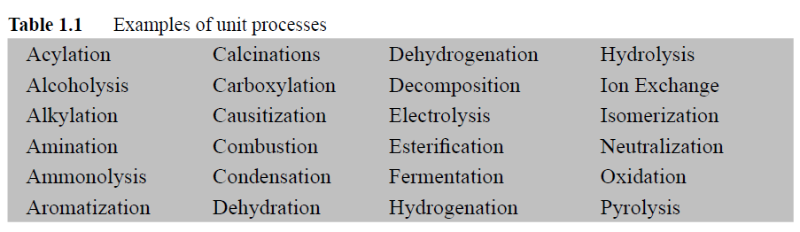
Chemical Processes
Every industrial process is designed to produce a desired product from a variety of
Raw materials using energy through a succession of treatment steps integrated in a rational fashion. The treatments steps are either physical or chemical in nature.
Unit processes
Unit processes are the chemical transformations or conversions that are performed
in a process.

Slide 9
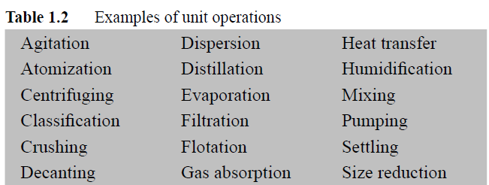
Unit operations
Unit operations are the physical treatment steps employed in chemical processes to transform raw materials and products into required forms.
put the raw materials in a form in which they can be reacted chemically
put the product in a form which is suitable for the market
Calcination
A chemical process is therefore any single processing unit or a combination of processing units used for the conversion of raw materials through any combination of chemical and physical treatment changes into finished products.

Slide 10
Flow Diagrams
A picture says more than a thousand words
Some chemical processes are quite simple; others such as oil refineries and petrochemical plants can be very complex. The process description of some processes could take a lot of text and time to read and still not yield 100% comprehension. Errors
resulting from misunderstanding processes can be extremely costly.
To simplify process description, flow diagrams also known as flow sheets are used.
A flow diagram is a road map of the process, which gives a great deal of information in a small space.
Chemical engineers use it to show the sequence of equipment and unit operations in the overall process to simplify the visualization of the manufacturing procedures and to indicate the quantities of material and energy transferred.
A flow diagram is not a scale drawing but it:
pictorially identifies the chemical process steps in their proper/logical sequence
includes sufficient details in order that a proper mechanical interpretation may
be made

Slide 11
Two types of flow diagrams are in common use, namely, the block diagrams and the
process flow diagrams.
Block Diagrams
This is a schematic diagram, which shows:
• what is to be done rather than how it is to be done. Details of unit operations/
processes are not given
• flow by means of lines and arrows
• unit operations and processes by figures such as rectangles and circles
• raw materials, intermediate and final products

Slide 12
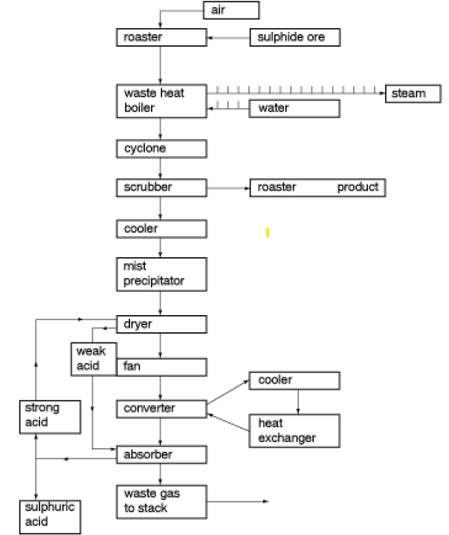
A block diagram for a sulphuric acid plant

Slide 13
Process flow diagram / flow sheet
Chemical plants are built from process flow drawings or flow sheets drawn by chemical engineers to communicate concepts and designs.
Communication is improved if accepted symbols are used. The advantages of correct use of symbols include:
The function being performed is emphasized by eliminating distractions caused by detail
Equipment symbols should neither dominate the drawing nor be too small for clear understanding.
Flow sheet symbols are pictorial quick-to-draw, easy-to-understand symbols that transcend language barriers.
Engineers are constantly devising their own symbols where standards do not exist. Therefore, symbols and presentation may vary from one designer or company to another.

Slide 14
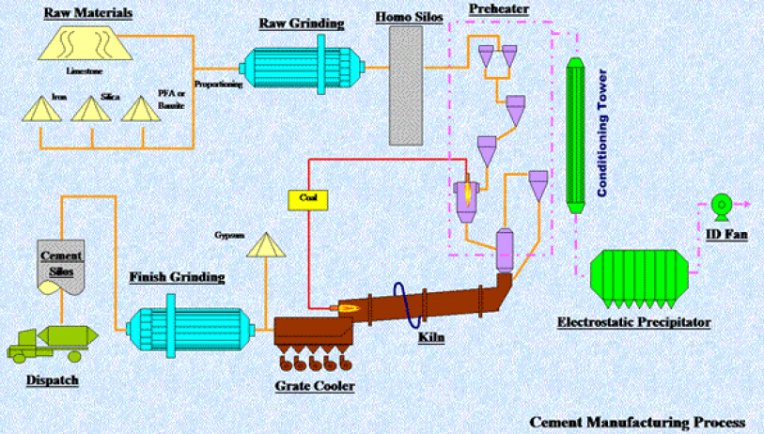
Cement process flow diagram illustrating the use of equipment symbols.

Slide 15
Process Control Systems in Industrial Processes
Process control systems make sure industrial processes are carried out efficiently, consistently and with as little variation as possible. They're installed in industrial settings to:
help maintain throughput, quality, yield and energy efficiency
make sure working practices are carried out safely and profitably
Systems measure, monitor and control manufacturing processes and activities.
They identify and correct any abnormalities or variations from specified values, either manually or automatically.

Slide 16
REFERENCES
Wanasolo William, Helen Njenga “Industrial Chemistry,” University of
Nairobi and William Wanasolo (2007).
Ahmed Daham “Basic Principles and Calculations in Chemical Engineering ,” University of Tikrit, 1st Edition

Slide 17
INTERACTION WITH STUDENTS
NOTE: Ask question if u have any queries about today’s lecture on whatsapp and discussion forum on LMS to describe how your personal bias might affect your interpretation of material presented today.
An interactive session will also be conducted on zoom meeting regarding queries about this lecture.

Slide 18


